Slide 1
Building a Simple Network
Exploring the Packet Delivery Process

Slide 2
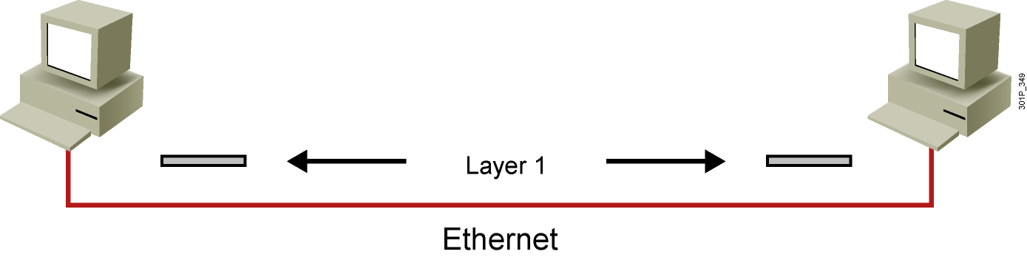
Layer 1 Devices
  Layer 1 provides the physical media and its encoding.
  Examples:
    Ethernet
    Serial
    Repeater
    Physical interface of the NIC
Notes:
Lesson Aim
<Enter lesson aim here.>

Slide 3
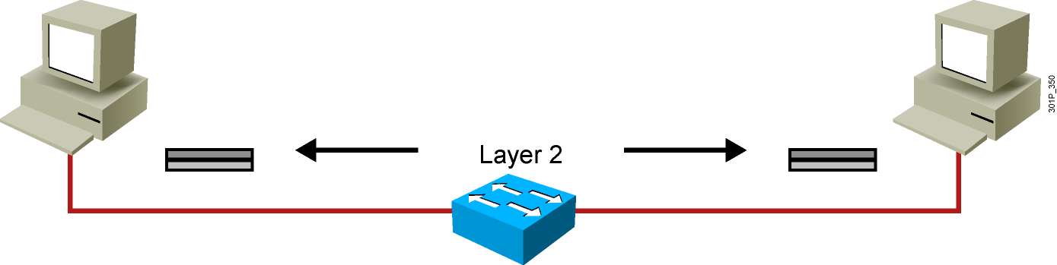
Layer 2 Devices
  Layer 2 devices provide an interface with the physical media.
  Examples:
    NIC
    Bridge
    Switch
Notes:
Lesson Aim
<Enter lesson aim here.>

Slide 4
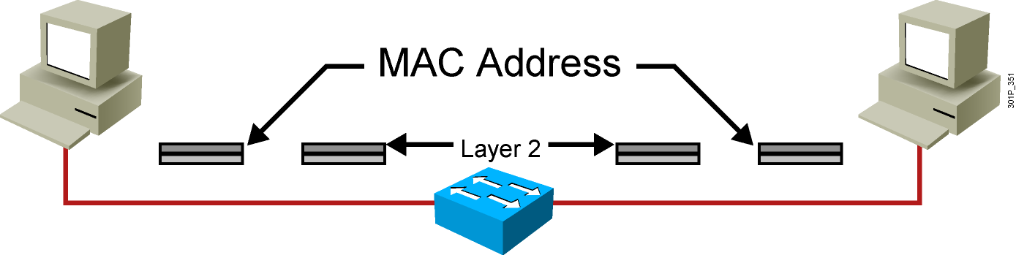
Layer 2 Addressing
  MAC address
  Assigned to end devices
Notes:
Lesson Aim
<Enter lesson aim here.>

Slide 5
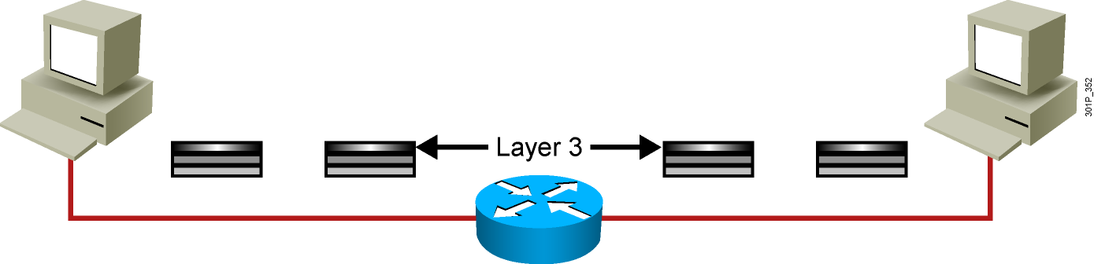
Layer 3 Devices and Their Function
  The network layer provides connectivity and path selection between two host systems.
  In the host, this is the path between the data link layer and the upper layers of the NOS.
  In the router, it is the actual path across the network.
Notes:
Lesson Aim
<Enter lesson aim here.>

Slide 6
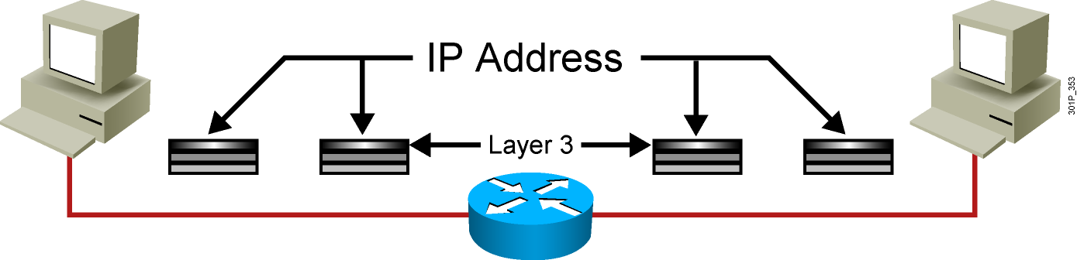
Layer 3 Addressing
  Each NOS has its own Layer 3 address format.
  OSI uses an NSAP.
  TCP/IP uses IP.
Notes:
Lesson Aim
<Enter lesson aim here.>

Slide 7
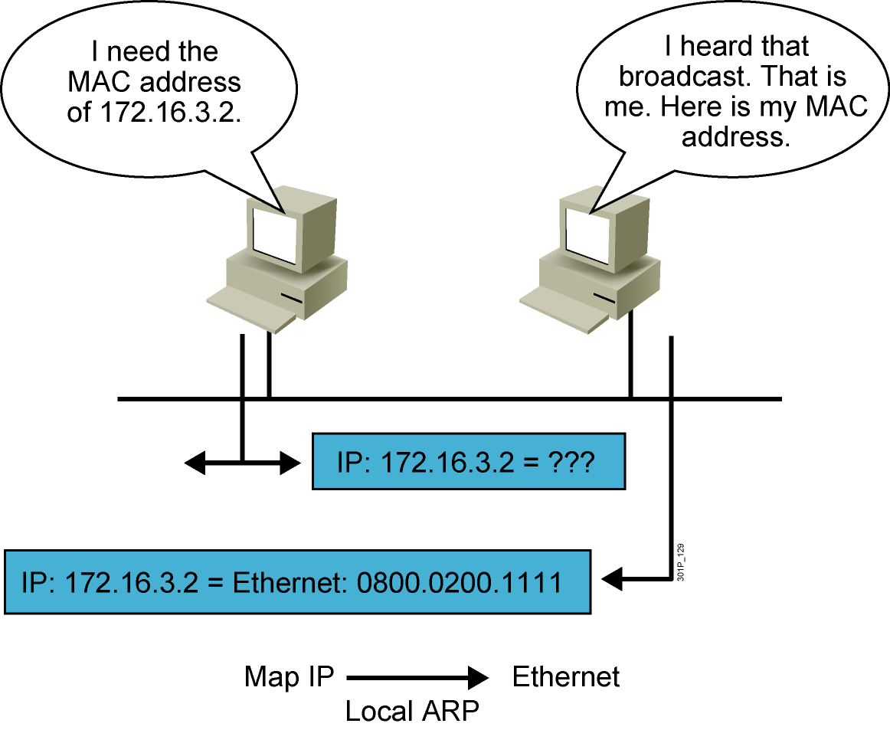
ARP
Notes:
Lesson Aim
<Enter lesson aim here.>

Slide 8
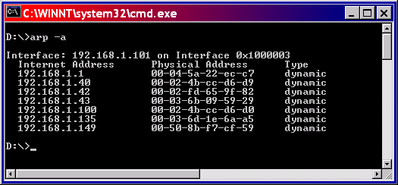
ARP Table

Slide 9
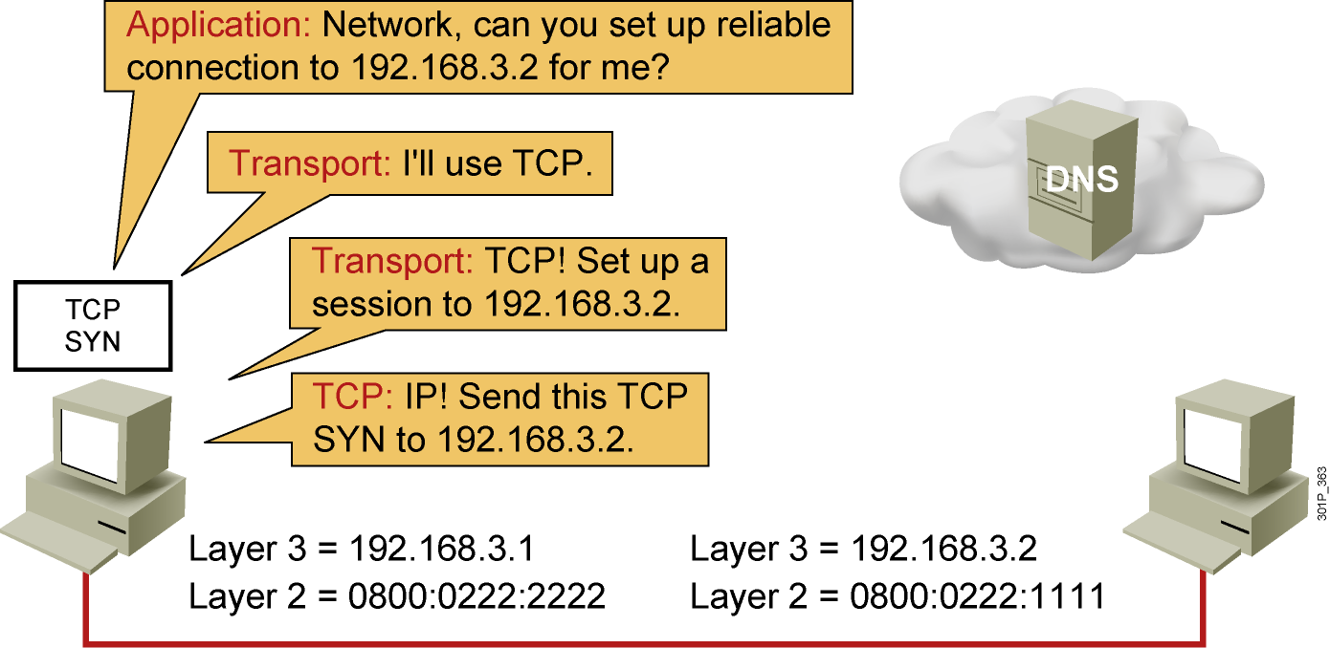
Host-to-Host Packet Delivery (1 of 22)
Notes:
Lesson Aim
<Enter lesson aim here.>

Slide 10
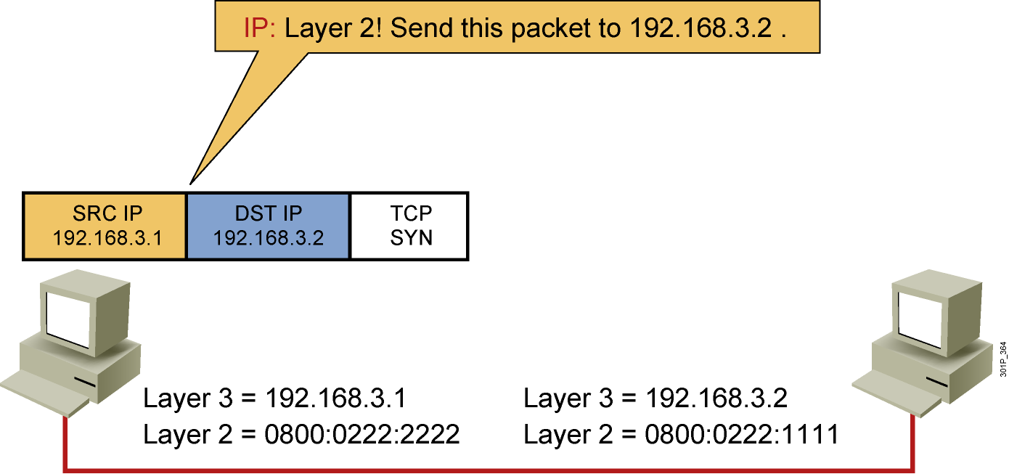
Host-to-Host Packet Delivery (2 of 22)
Notes:
Lesson Aim
<Enter lesson aim here.>

Slide 11
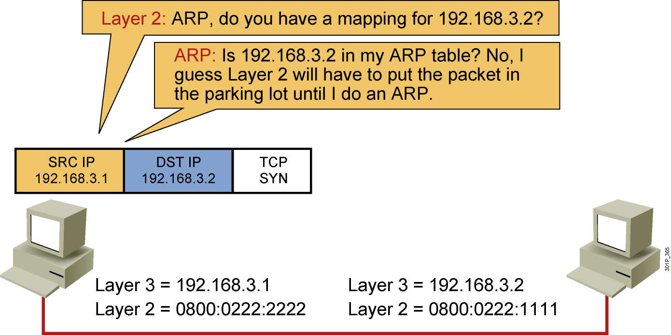
Host-to-Host Packet Delivery (3 of 22)
Notes:
Lesson Aim
<Enter lesson aim here.>

Slide 12
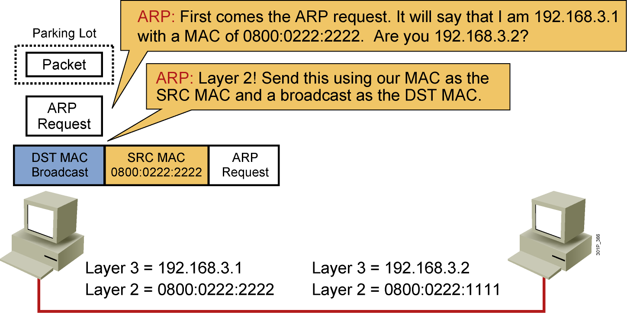
Host-to-Host Packet Delivery (4 of 22)
Notes:
Lesson Aim
<Enter lesson aim here.>

Slide 13
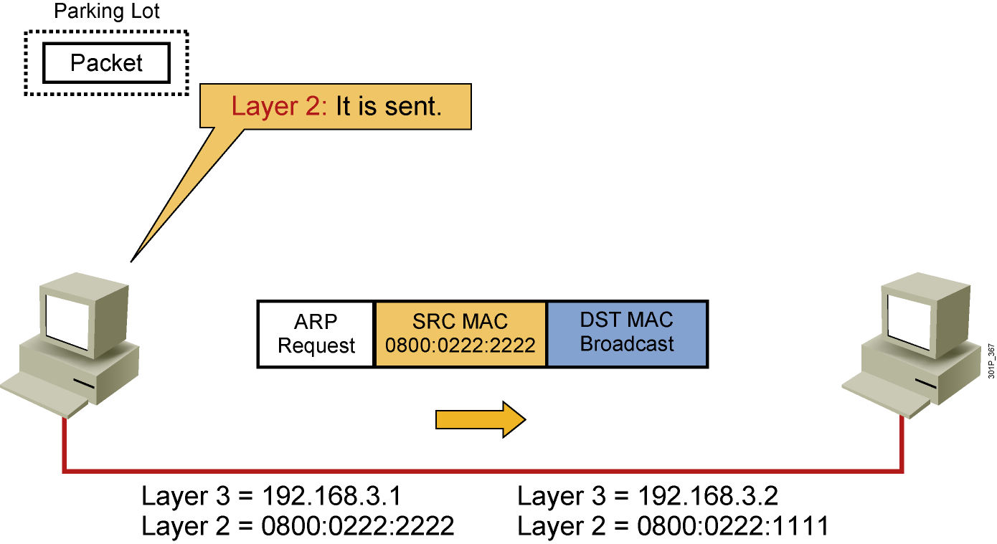
Host-to-Host Packet Delivery (5 of 22)
Notes:
Lesson Aim
<Enter lesson aim here.>

Slide 14
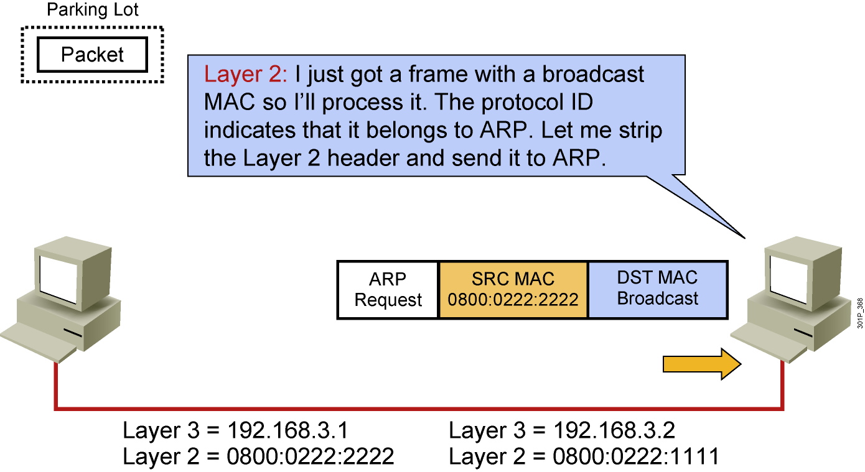
Host-to-Host Packet Delivery (6 of 22)
Notes:
Lesson Aim
<Enter lesson aim here.>

Slide 15
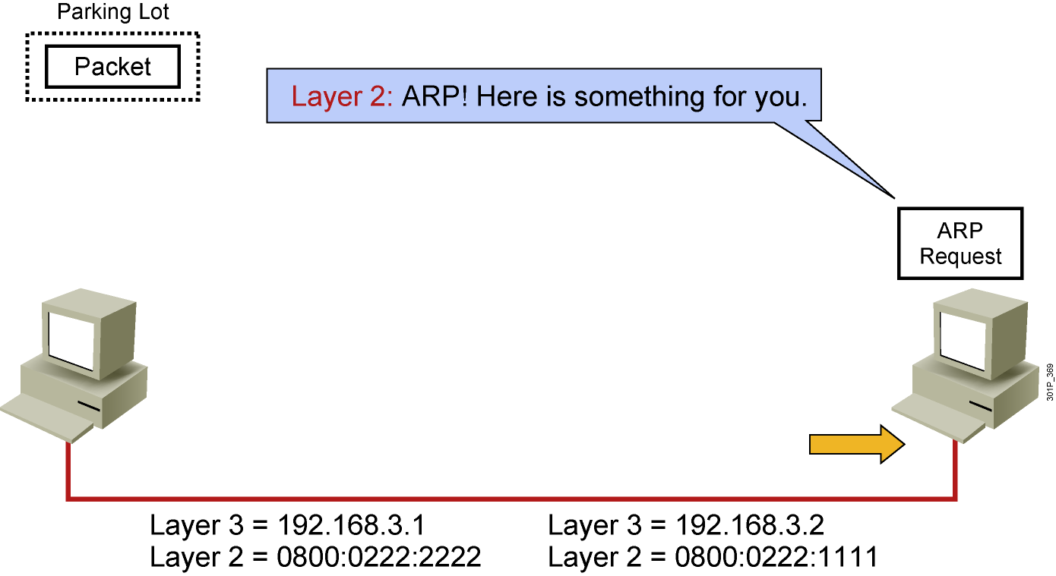
Host-to-Host Packet Delivery (7 of 22)
Notes:
Lesson Aim
<Enter lesson aim here.>

Slide 16
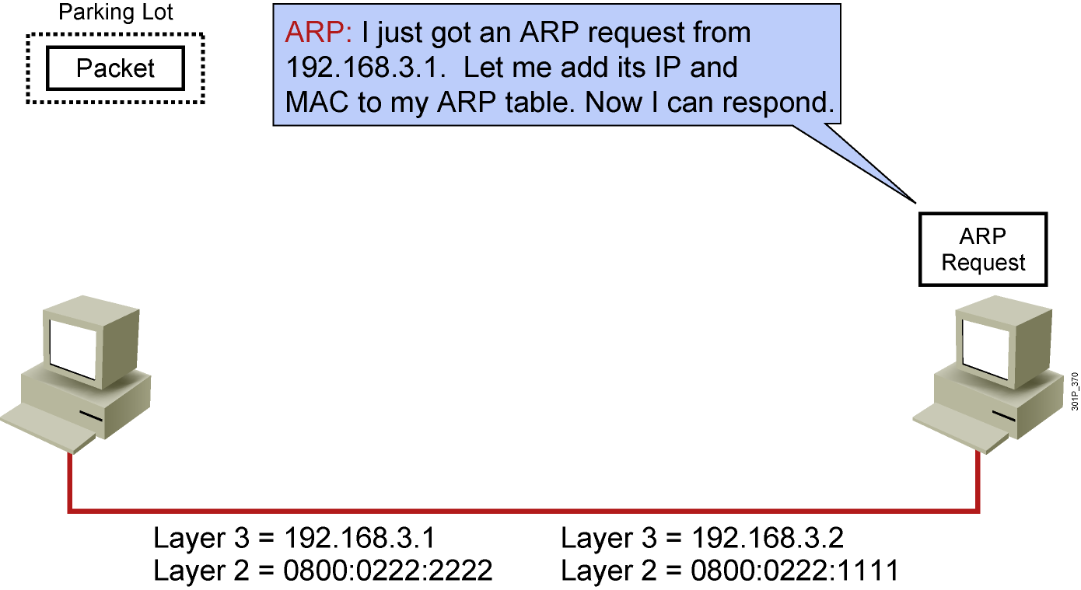
Host-to-Host Packet Delivery (8 of 22)
Notes:
Lesson Aim
<Enter lesson aim here.>

Slide 17
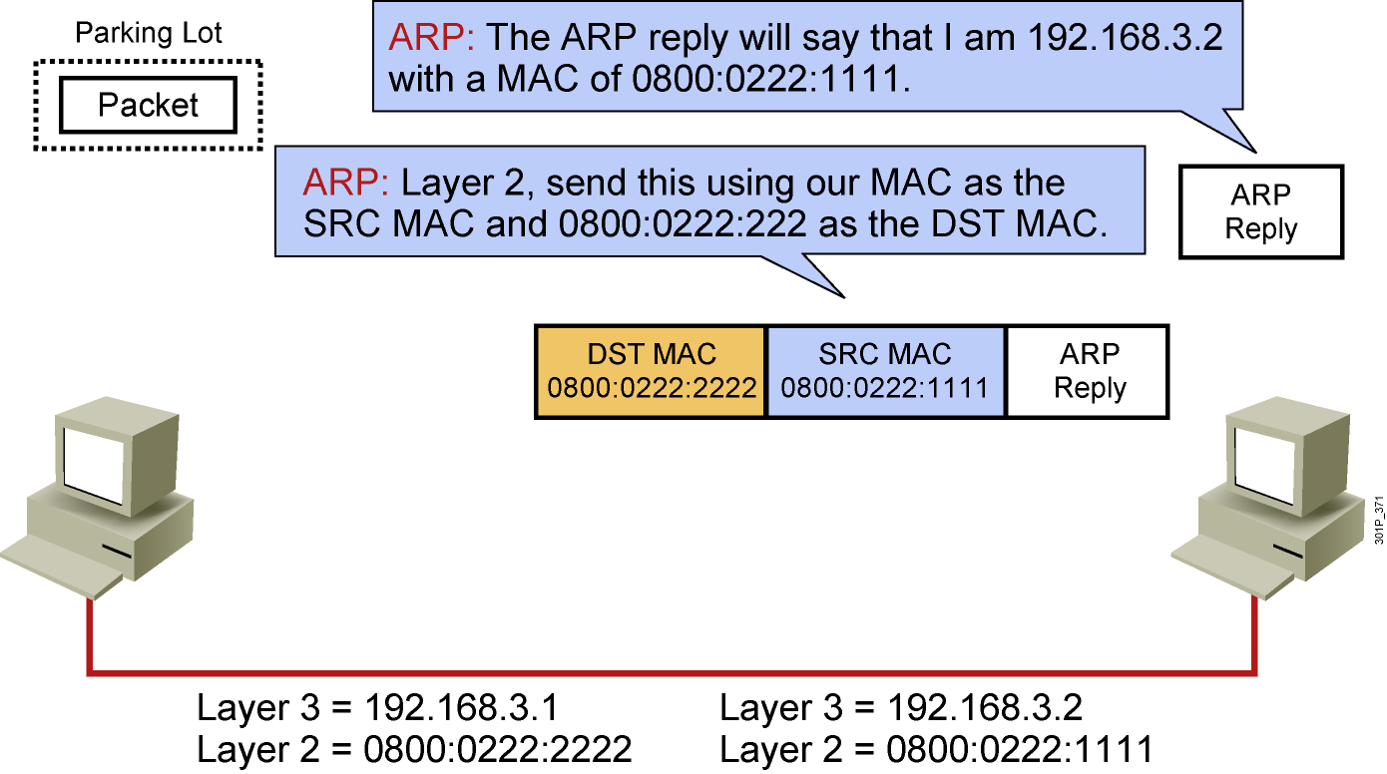
Host-to-Host Packet Delivery (9 of 22)
Notes:
Lesson Aim
<Enter lesson aim here.>

Slide 18
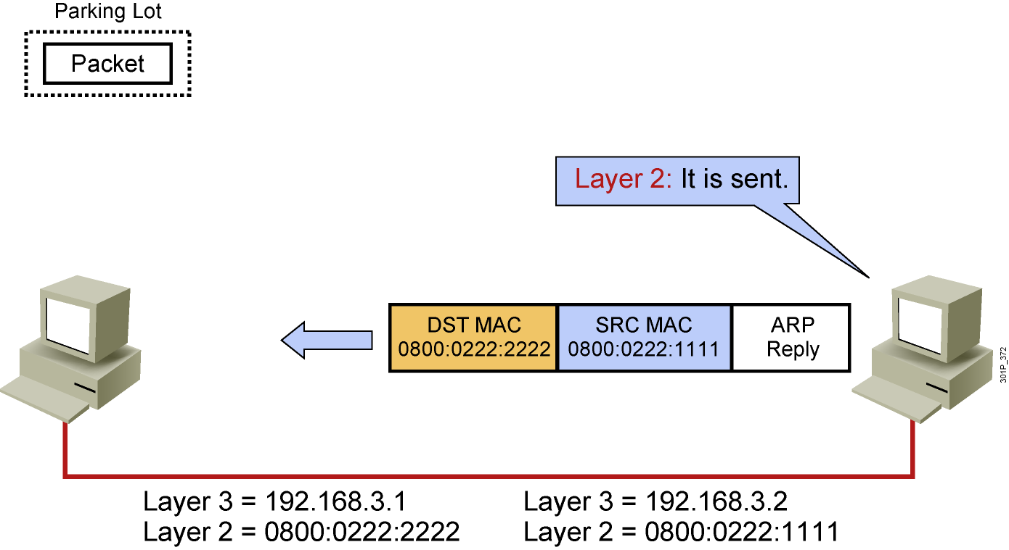
Host-to-Host Packet Delivery (10 of 22)
Notes:
Lesson Aim
<Enter lesson aim here.>

Slide 19
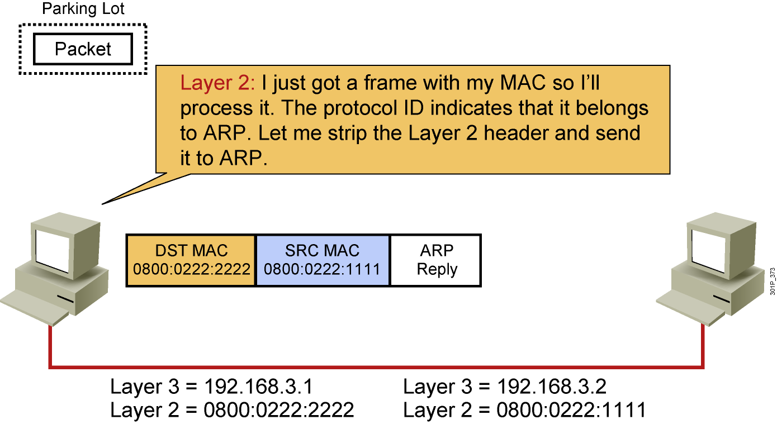
Host-to-Host Packet Delivery (11 of 22)
Notes:
Lesson Aim
<Enter lesson aim here.>

Slide 20
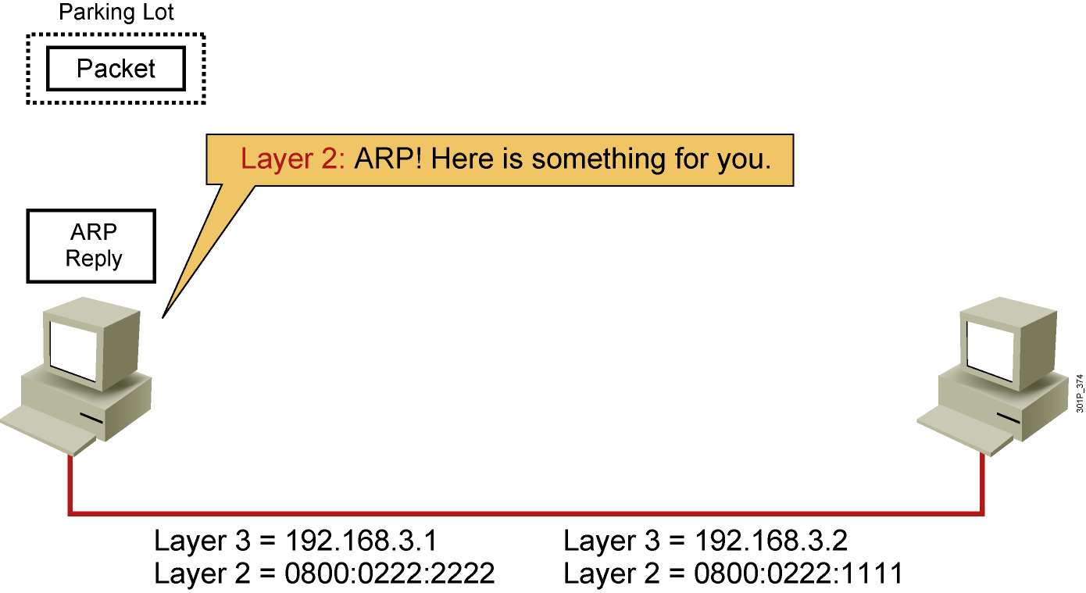
Host-to-Host Packet Delivery (12 of 22)
Notes:
Lesson Aim
<Enter lesson aim here.>

Slide 21
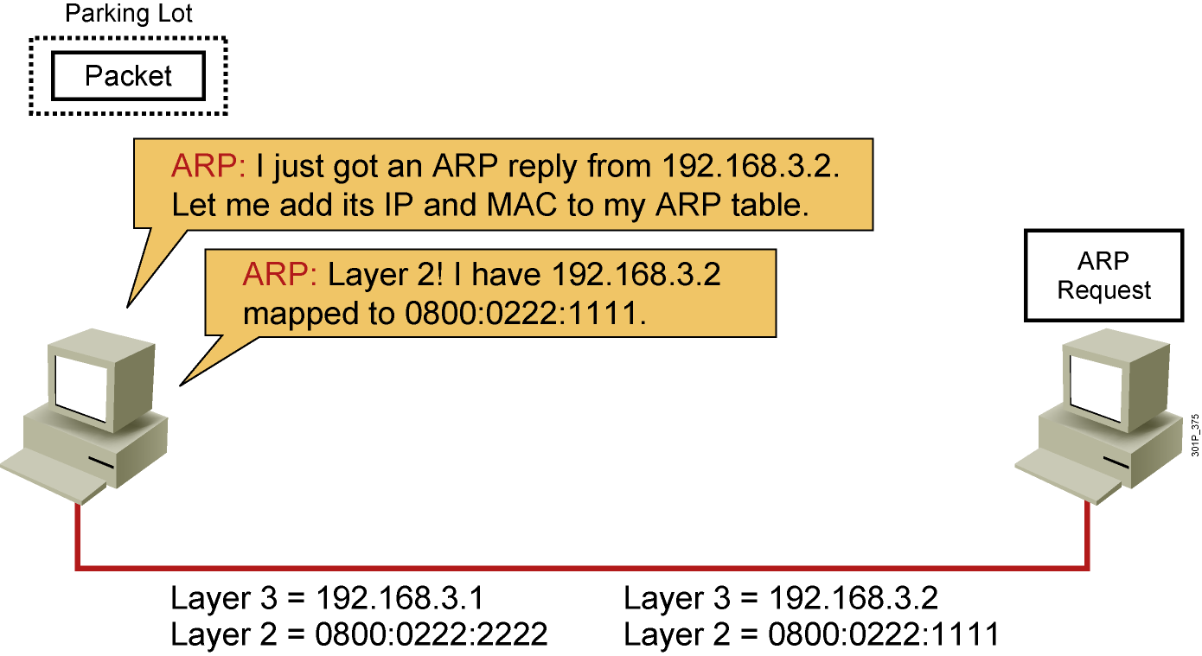
Host-to-Host Packet Delivery (13 of 22)
Notes:
Lesson Aim
<Enter lesson aim here.>

Slide 22
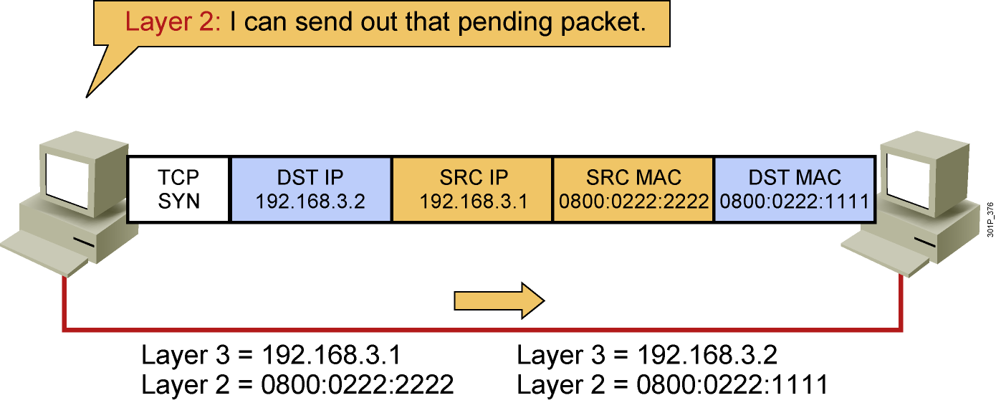
Host-to-Host Packet Delivery (14 of 22)
Notes:
Lesson Aim
<Enter lesson aim here.>

Slide 23
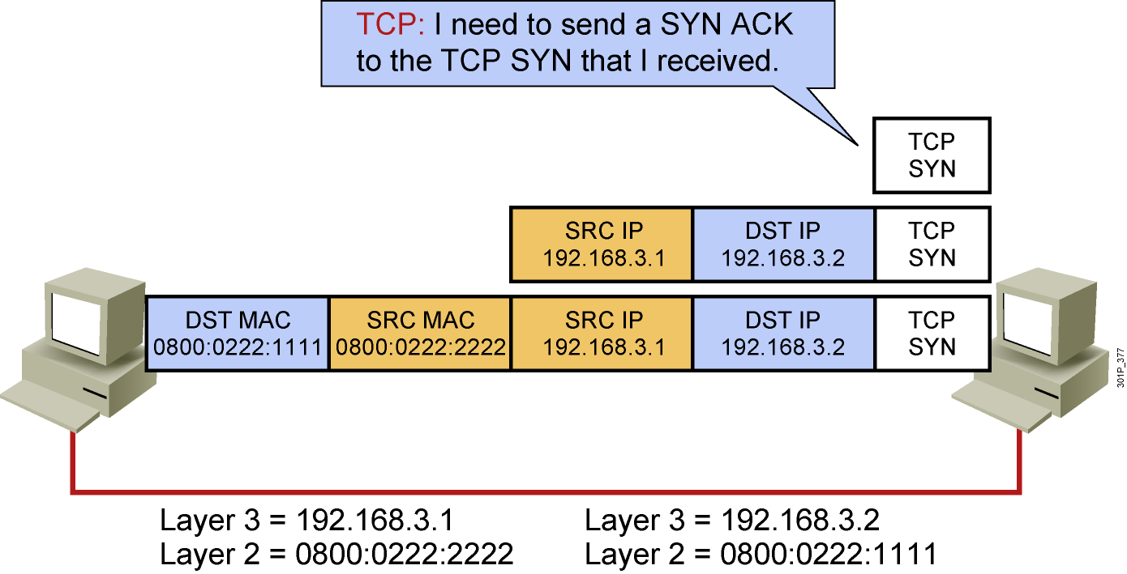
Host-to-Host Packet Delivery (15 of 22)
Notes:
Lesson Aim
<Enter lesson aim here.>

Slide 24
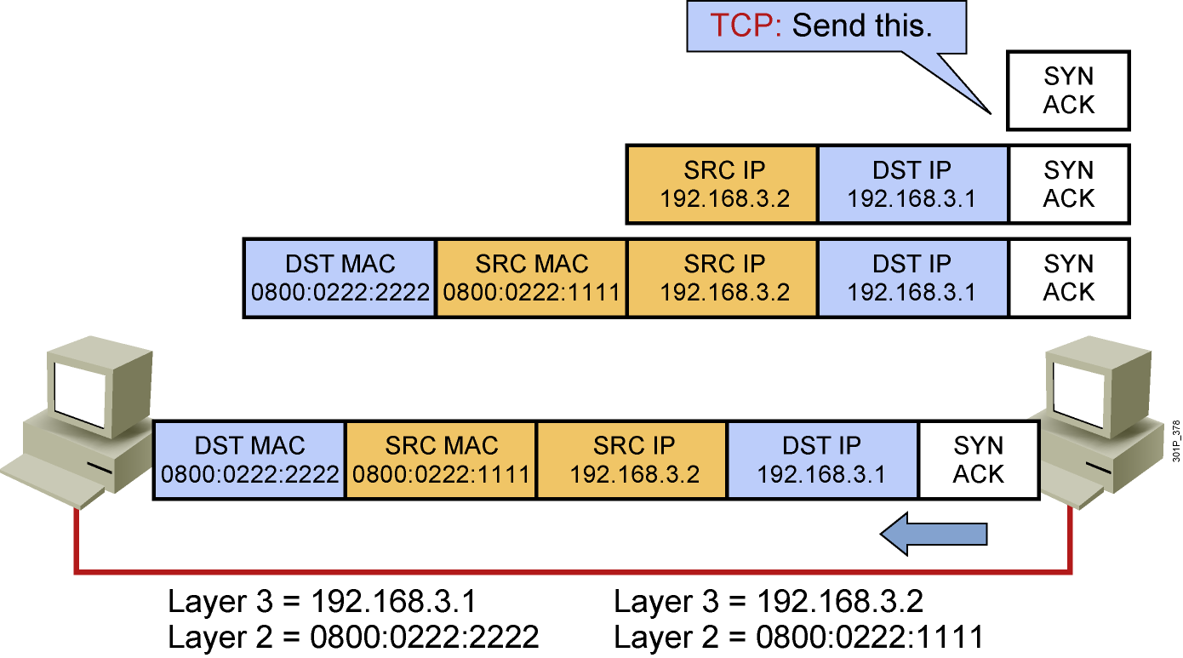
Host-to-Host Packet Delivery (16 of 22)
Notes:
Lesson Aim
<Enter lesson aim here.>

Slide 25
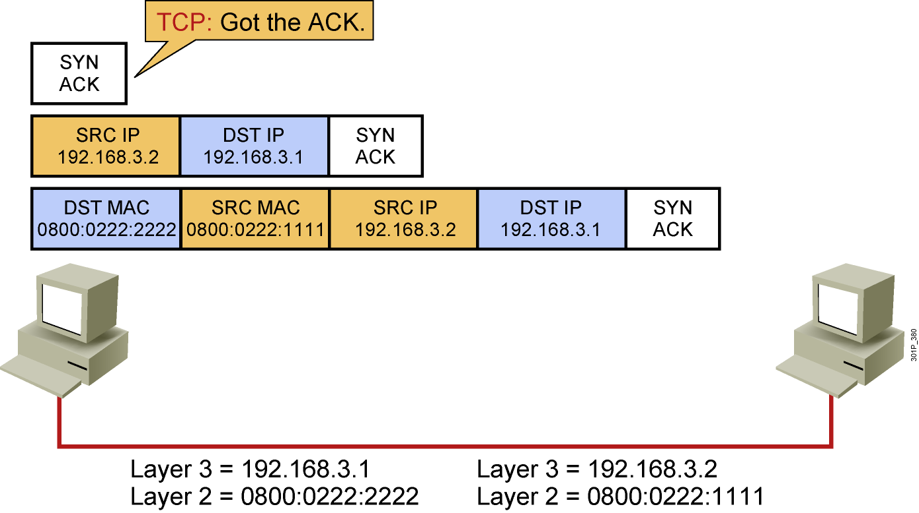
Host-to-Host Packet Delivery (17 of 22)
Notes:
Lesson Aim
<Enter lesson aim here.>

Slide 26
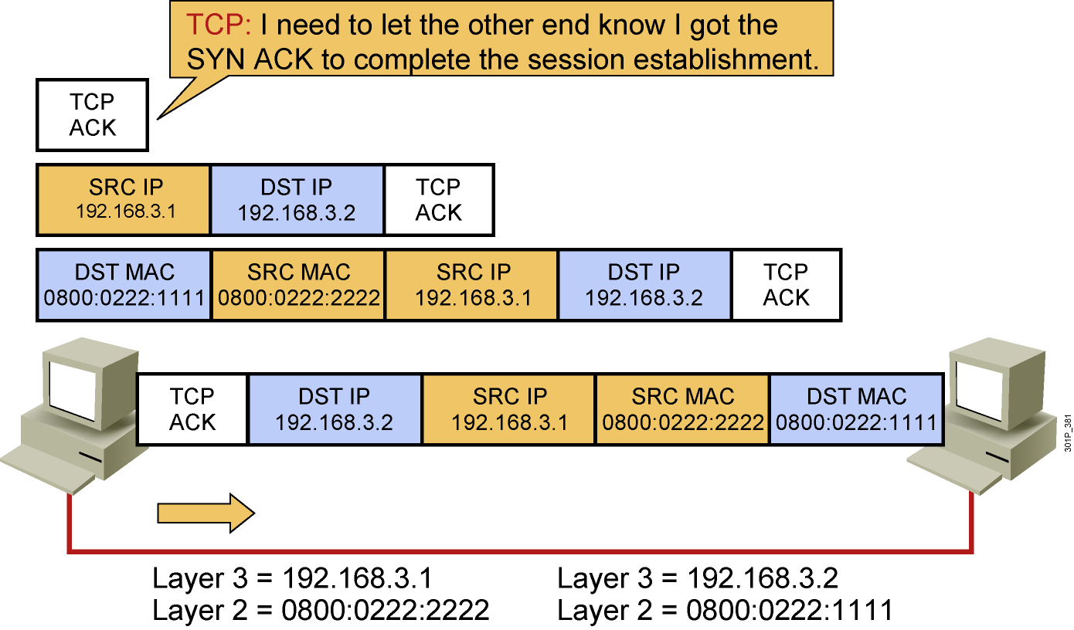
Host-to-Host Packet Delivery (18 of 22)
Notes:
Lesson Aim
<Enter lesson aim here.>

Slide 27
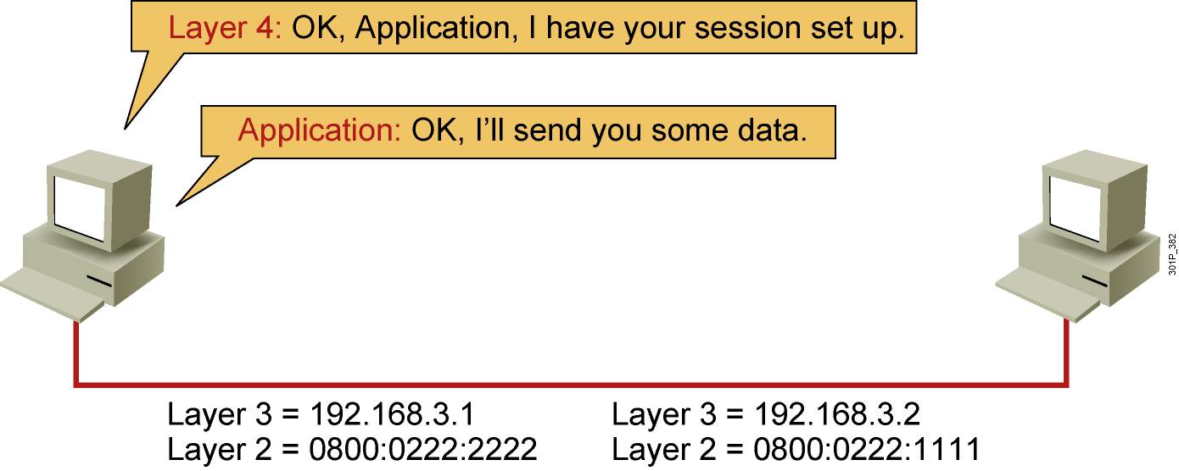
Host-to-Host Packet Delivery (19 of 22)
Notes:
Lesson Aim
<Enter lesson aim here.>

Slide 28
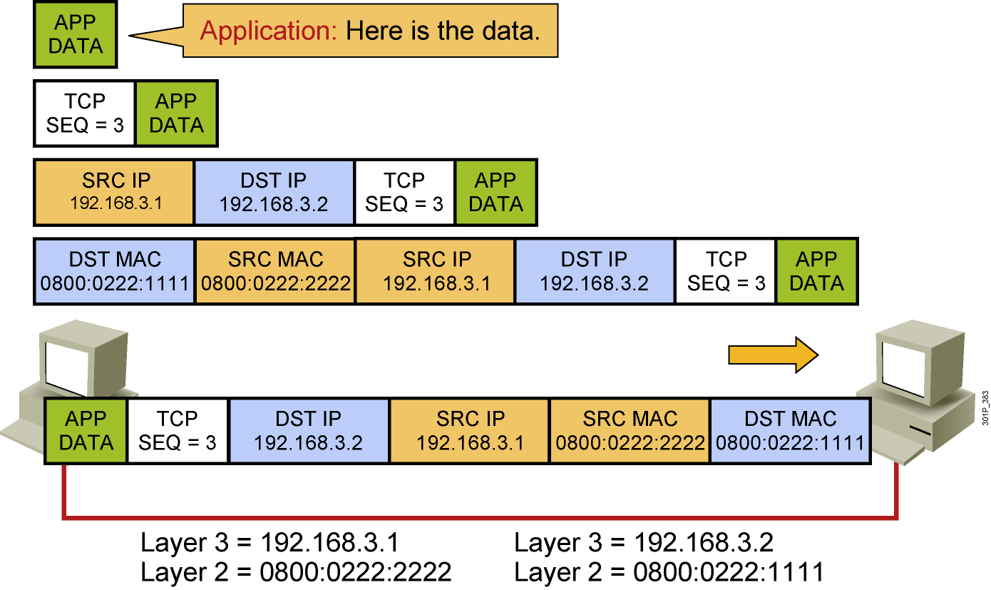
Host-to-Host Packet Delivery (20 of 22)
Notes:
Lesson Aim
<Enter lesson aim here.>

Slide 29
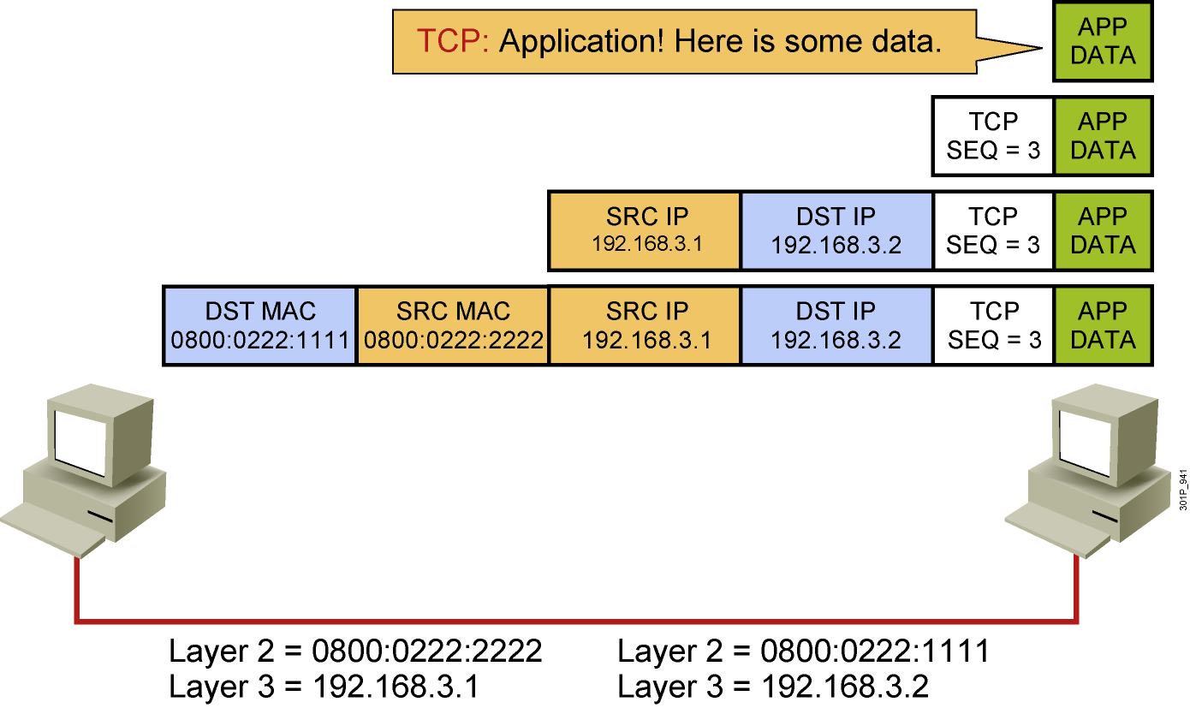
Host-to-Host Packet Delivery (21 of 22)
Notes:
Lesson Aim
<Enter lesson aim here.>

Slide 30
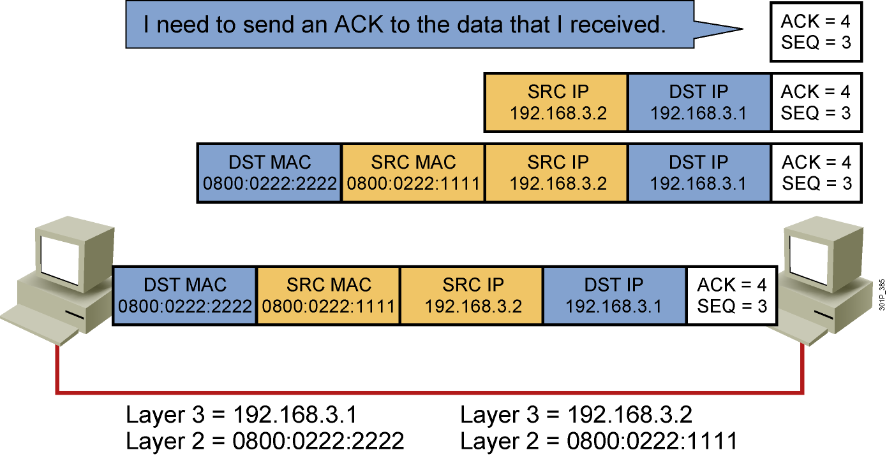
Host-to-Host Packet Delivery (22 of 22)
Notes:
Lesson Aim
<Enter lesson aim here.>

Slide 31
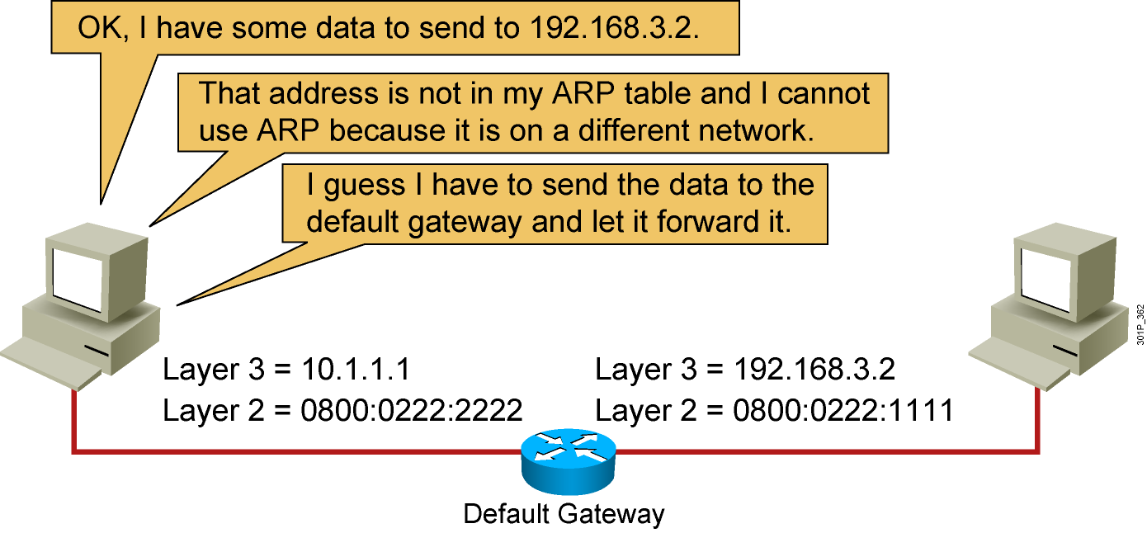
Default Gateway
Notes:
Lesson Aim
<Enter lesson aim here.>

Slide 32
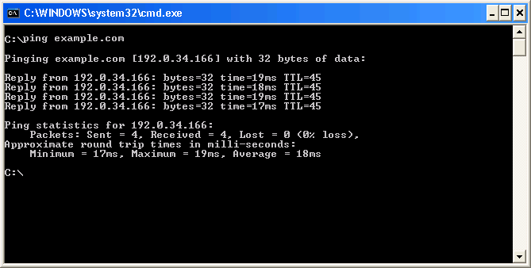
Host-Based Tools: ping

Slide 34
Host-Based Tools: Table

Slide 35
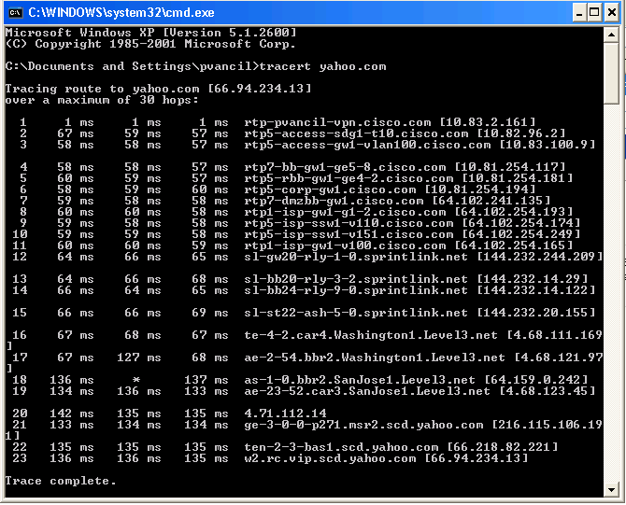
Host-Based Tools: tracert

Slide 37
Summary
  Layer 1 provides the physical media and its encoding.
  Layer 2 devices provide an interface with the physical media.
  Layer 2 addresses are MAC addresses.
  The network layer provides connectivity and path selection between two host systems.
  Layer 3 addresses are IP addresses.

Slide 38
Summary (Cont.)
  Before a host can send data to another host, it must have the MAC address of that host.
  If the MAC address is not known, ARP is used to map Layer 2 to Layer 3.
  Reliable communication requires a TCP session.
  Data sent must be acknowledged.
  If hosts are on different segments, a default gateway is needed.
  Several host-based tools are available to check connectivity between hosts:
    ping
    tracert
    arp

